Slide 1
Generative
vs Discriminative Methods
Materials: http://bit.ly/2rXpZjp
Attendance: http://bit.ly/33W1zoo
PIN: 920501

Slide 2
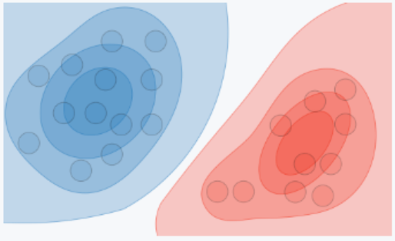
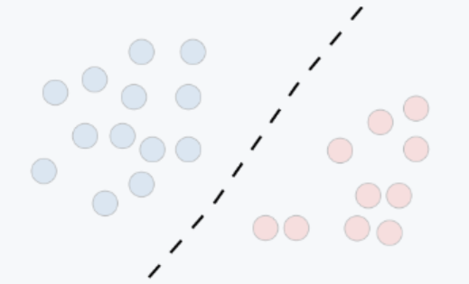
Generative vs Discriminative
Generative Approach:
Learn the joint probability distribution P(x,y) of a set of data to model the actual distribution of each class.
Can ‘generate’ synthetic data points
Discriminative Approach:
Learn the conditional probability distribution P(y|x) to model decision boundaries between classes.
Directly ‘distinguishes’ between posterior probabilities

Slide 3
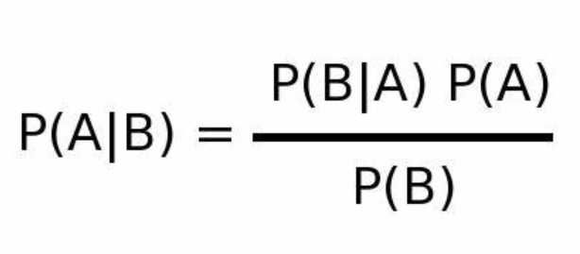
Probability Theory Background
Joint Probability: Likelihood of events A and B occuring together
Conditional Probability: Likelihood of event B occurring given that event A has occurred
Bayes Theorem:
Probability Density Function: A function of a continuous random variable where any given point gives the relative likelihood that a sample equals the random variable.

Slide 4
Comparison of Methods
Generative Methods:
Naive Bayes
Bayesian Networks
Hidden Markov Model (HMM)
Gaussian Mixture Model (GMM)
Variational Autoencoder (VAE)
Generative Adversarial Network (GAN)
Discriminative Methods:
Logistic regression
k-Nearest Neighbors (kNN)
Decision Trees
Support Vector Machine (SVM)
Conditional Random Fields (CRF)
Traditional Neural Networks

Slide 5
Pros and Cons
Generative Models:
Pros:
Good for unsupervised learning
Describes the distribution
Cons:
Computationally expensive
Might need prior knowledge
Discriminative Models:
Pros:
Less data needed
Very efficient with good results
Cons:
Difficult to interpret
Can’t do unsupervised learning

Slide 6

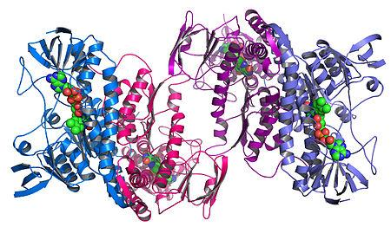
Applications
NLP
Medical Diagnosis
Bioinformatics and Genomics
Human image synthesis

Slide 7
Resources
Ng, Andrew Y.; Jordan, Michael I. (2002). "On discriminative vs. generative classifiers: A comparison of logistic regression and naive bayes". Advances in Neural Information Processing Systems.
Jebara, Tony (2004). Machine Learning: Discriminative and Generative. Kluwer Academic (Springer).
https://www.thispersondoesnotexist.com/

